Slide 1

Criminal justice system
Industrialization and urbanization created unique social spaces that raised questions on racial tensions yet capitalism led them to reform to criminal justice in a manner that was unacceptable to the Mexicans.
The Americans rose in wrath to the indignation and perversion of the machinery that was delegated to the Mexicans. In other respects, the execution varied from general tendencies in the legal systems.
Small secretive mobs were common among the Mexicans yet the overwhelming majority were the Americans who constituted the federal government.

Slide 2
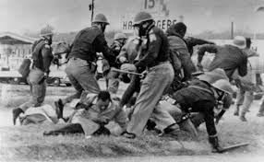
Police brutality sparked riots in communities, primarily Mexican and their neighborhoods, the lack of understanding of police violence among the Mexicans lead to selective outrage to strikingly similar incidents.

Slide 3
Discoveries
From research, there is a possibility that the Mexicans leaders ignore police brutality out of fear that there may be concerns of association with the black issues.
The negligence of the Mexicans also undermines the courageous work of generational activists who toiled to mend the [police relations with the people.
The people of Mexico are still proportionately targeted by law enforcement policies. Many households were an easy target by the Americans.

